Slide 1
Object Oriented Programming—C++ Lecture4 Containers & Iterators
Qijun Zhao
College of Computer Science
Sichuan University
Spring 2025

Slide 2
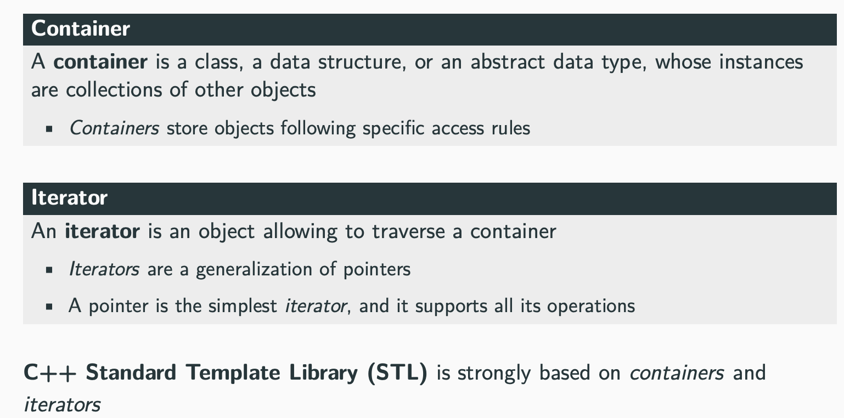
Containers and Iterators Overview

Slide 3
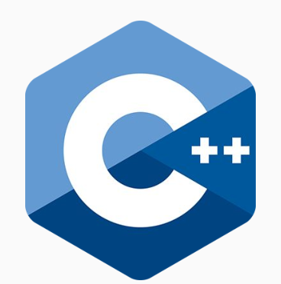
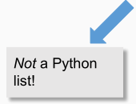
Containers in STL
The STL has many types of containers:
Both familiar ones:
● Vector
● Stack
● Queue
● Set
● Map
And unfamiliar ones:
● Array
● Deque
● List
● Unordered set
● Unordered map

Slide 4
Sequence Container: Overview
Sequence containers are data structures storing objects of the same data type in a linear manner
The STL Sequence Containers include:
● std::array provides a fixed-size contiguous array (on stack)
● std::vector provides a dynamic contiguous array
● std::list provides a double-linked list
● std::deque provides a double-ended queue
● std::forward_list provides a single-linked list
While std::string is not included in most container lists, it actually meets the requirements of a Sequence Container

Slide 5
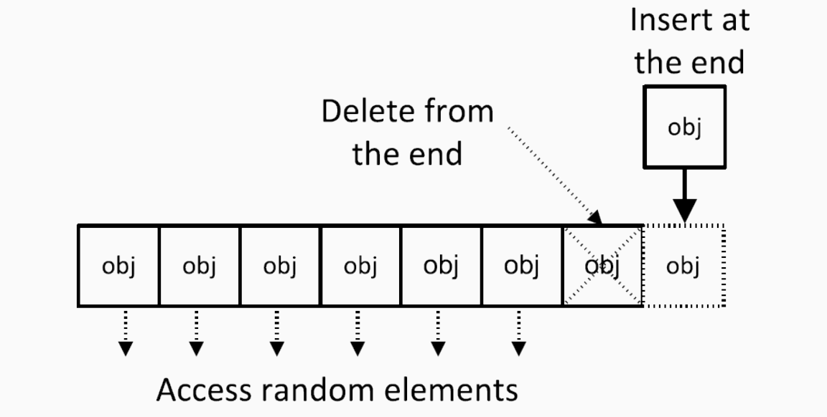
std::vector
● resize() resizes the allocated elements of the container
● capacity() number of allocated elements
● reserve() resizes the allocated memory of the container (not size)
● shrink_to_fit() reallocate to remove unused capacity
● clear() removes all elements from the container (no reallocation)

Slide 6
Vector implementation
How do vectors actually work?
● At a high level, a vector is an ordered collection of
elements of the same type that can grow and shrink in
size.
Internally, vectors implement an array!

Slide 7
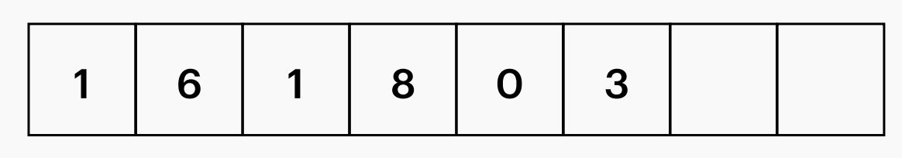
Vector implementation
We keep track of a few member variables:
● _size = number of elements in the vector
● _capacity = space allocated for elements
Don’t confuse these two!

Slide 8
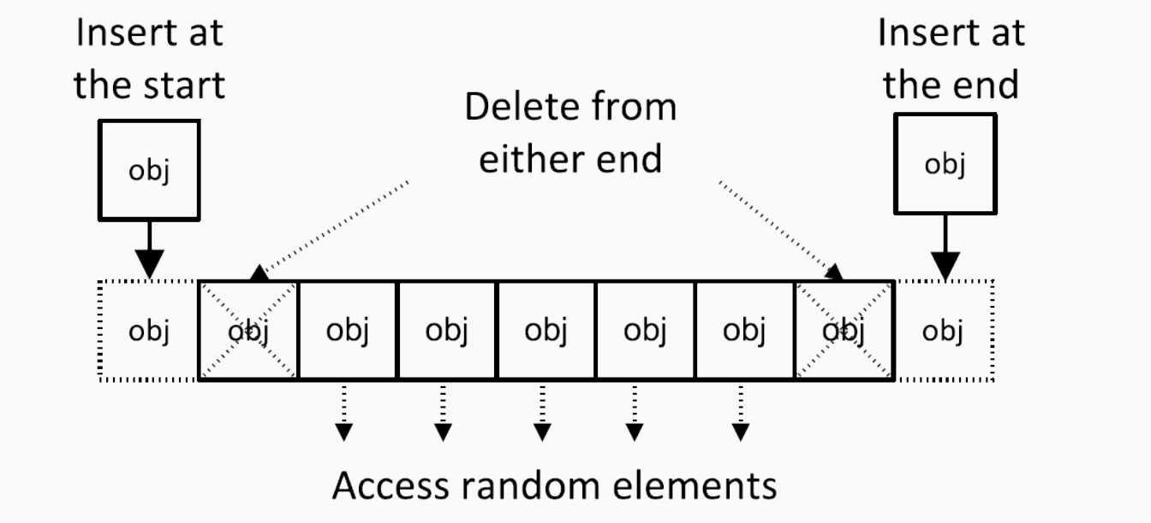
std::deque
● resize() resizes the allocated elements of the container
● shrink_to_fit() reallocate to remove unused capacity
● clear() removes all elements from the container (no reallocation)

Slide 9
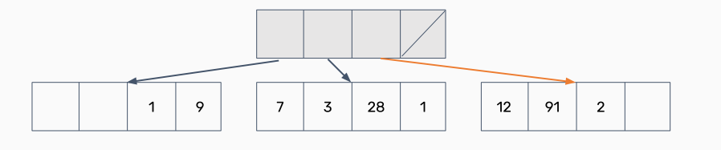
Deque implementation
Deques can be implemented many different ways! Here’s one:
● What if we had an array that stored other arrays?

Slide 10
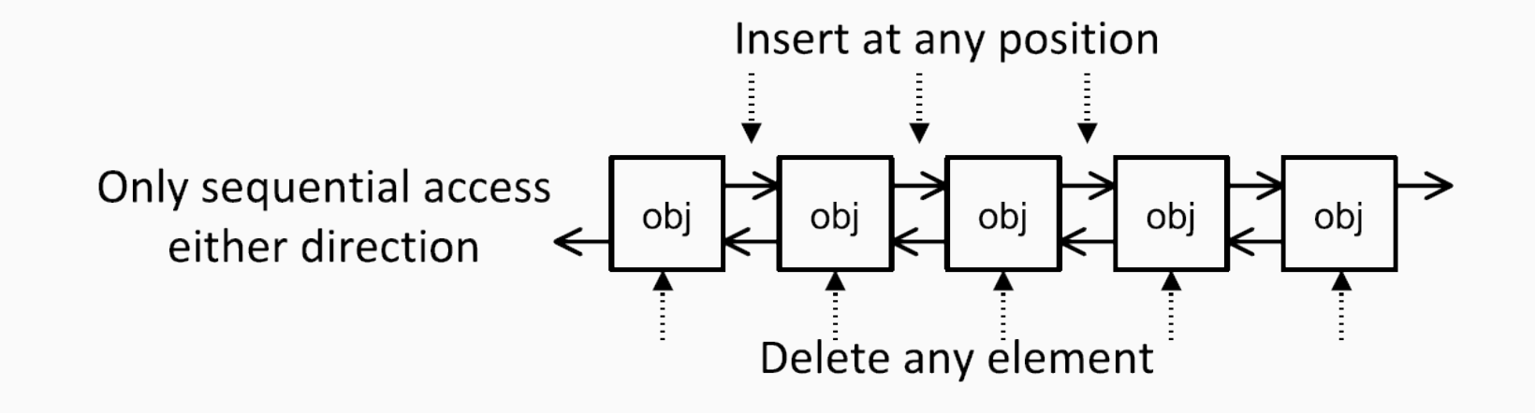
std::list
● resize() resizes the allocated elements of the container
● shrink_to_fit() reallocate to remove unused capacity
● clear() removes all elements from the container (no reallocation)
● remove() removes all elements satisfying specific criteria

Slide 11
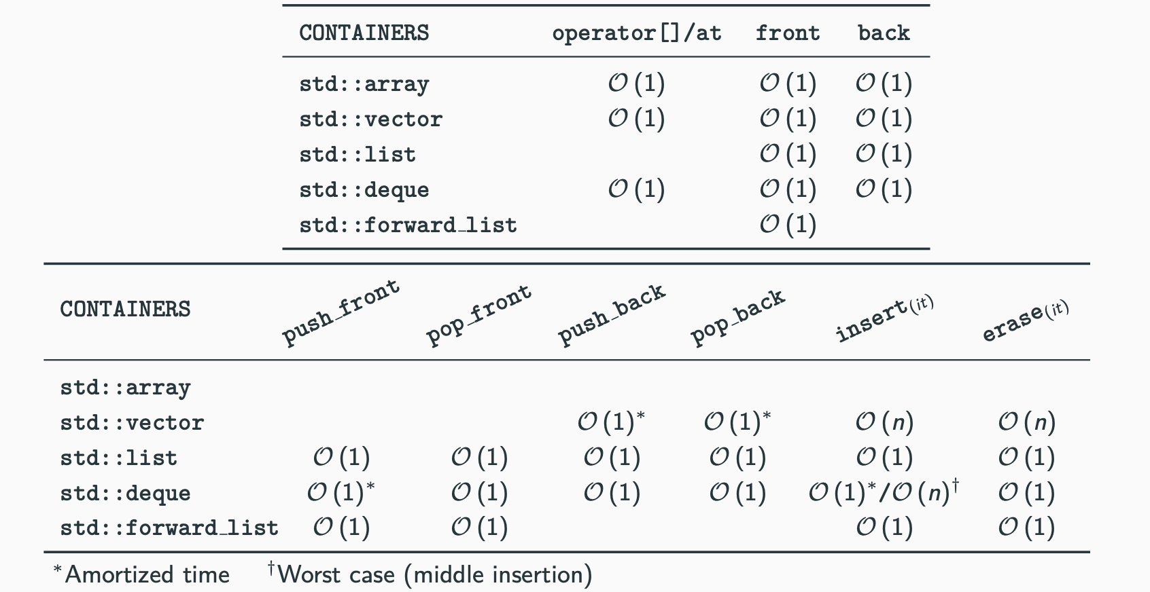
Supported Operations and Complexity

Slide 12
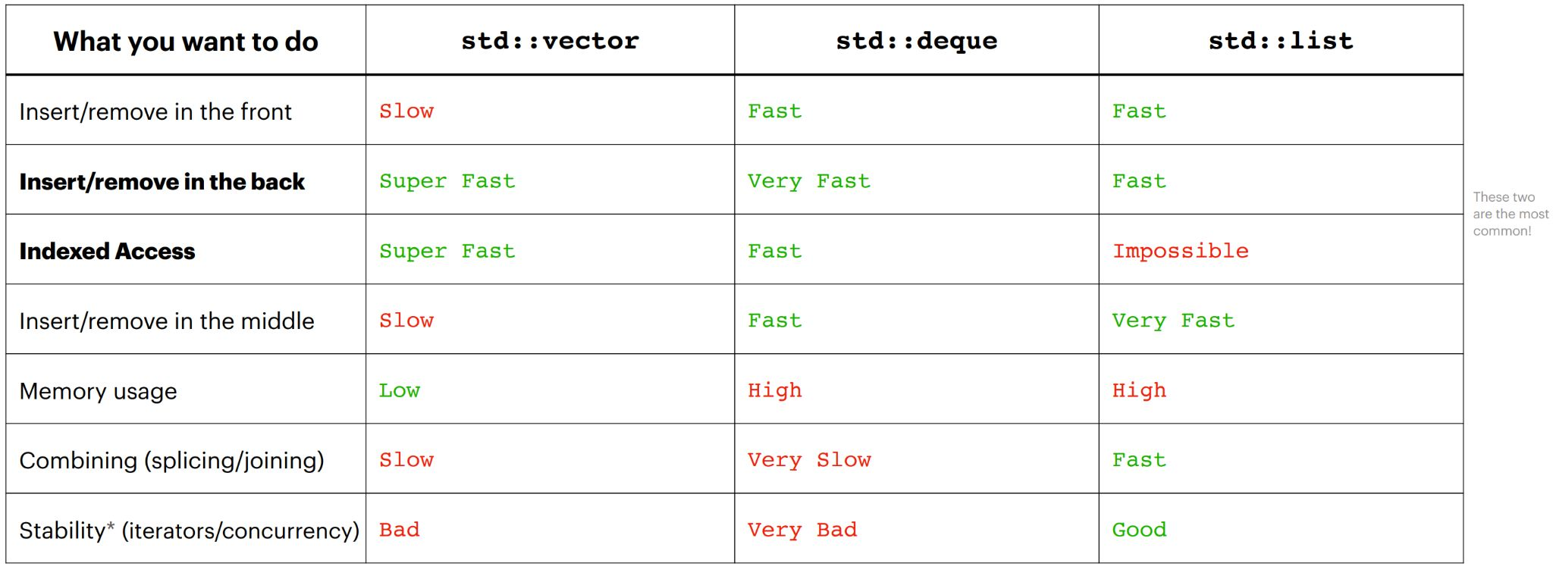
Choosing sequence containers

Slide 13
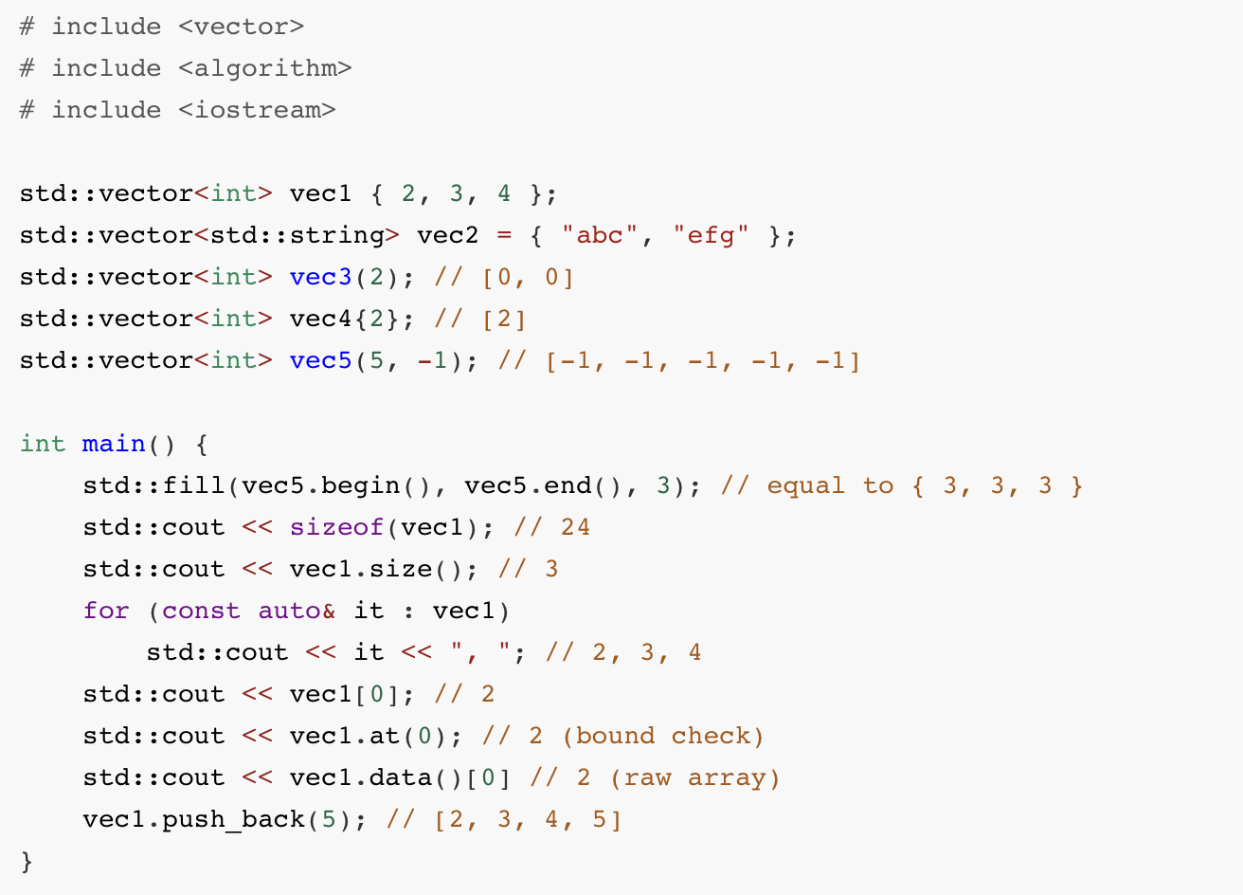
std::vector example

Slide 14
Associative Containers
An associative container is a collection of elements not necessarily indexed with sequential integers and that supports efficient retrieval of the stored elements through keys
Keys are unique:
● std::set is a collection of sorted unique elements (operator<)
● std::unordered_set is a collection of unsorted unique keys
● std::map is a collection of unique pairs, sorted by keys
● std::unordered map is a collection of unique pairs, unsorted
Multiple entries for the same key are permitted
● std::multiset is a collection of sorted elements (operator<)
● std::unordered_multiset is a collection of unsorted elements
● std::multimap is a collection of pairs, sorted by keys
Notes:
associative containers: 关联（式）容器

Slide 15
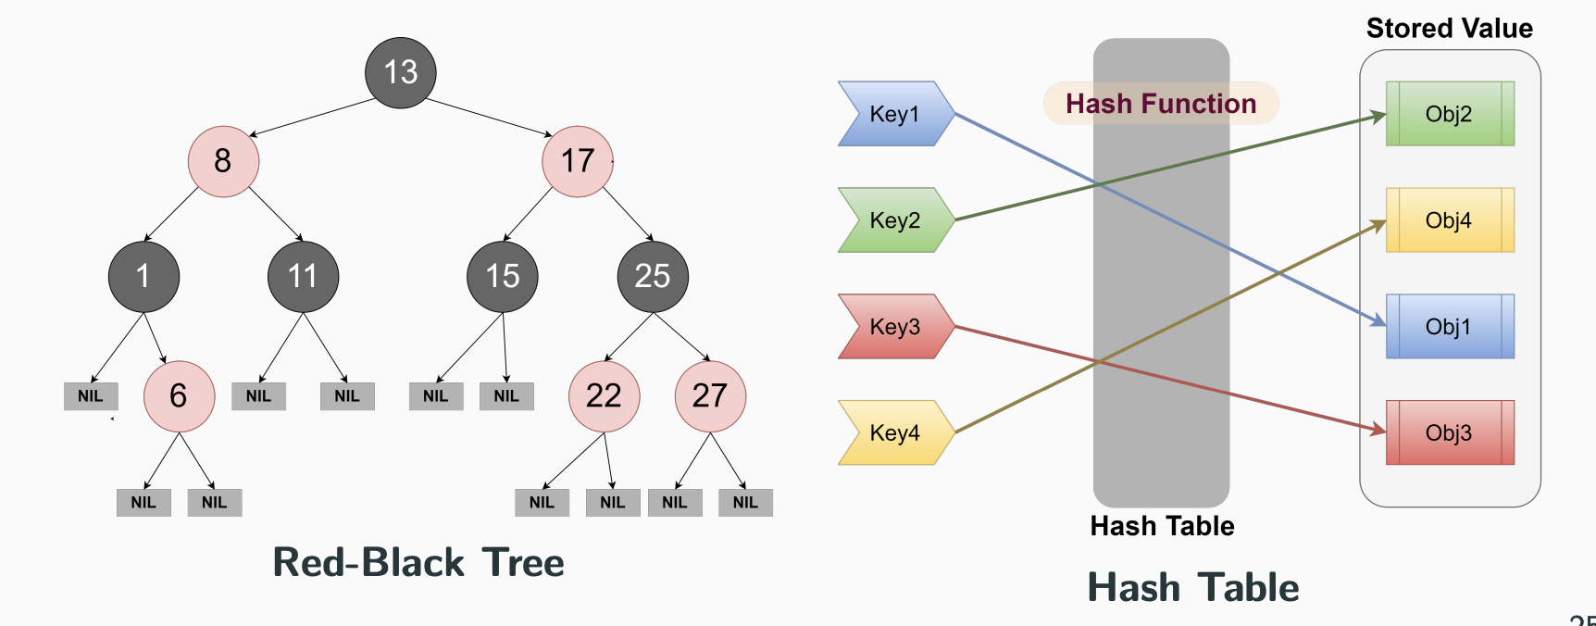
Internel Representation
Sorted associative containers are typically implemented using red-black trees,
unordered associative containers (C++11) are implemented using hash tables

Slide 16
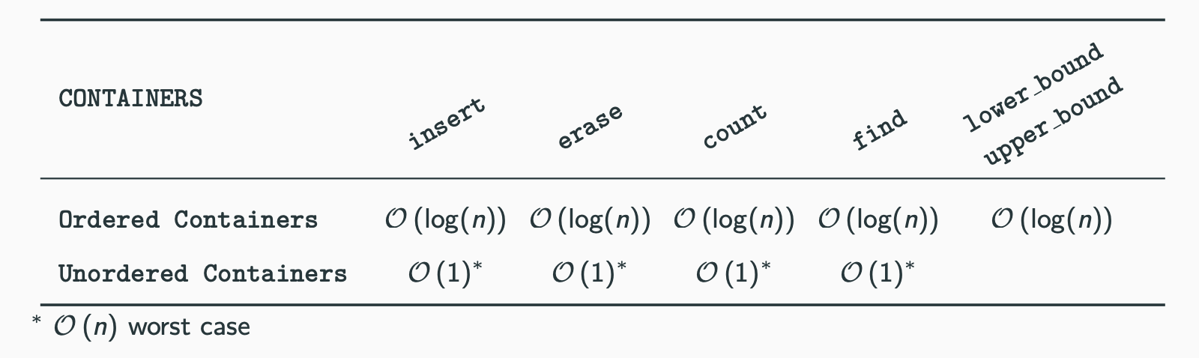
Supported Operations and Complexity
● count() returns the number of elements with key equal to a specified argument
● find() returns the element with key equal to a specified argument
● lower bound() returns an iterator pointing to the first element that is not less than key
● upper bound() returns an iterator pointing to the first element that is greater than key

Slide 17
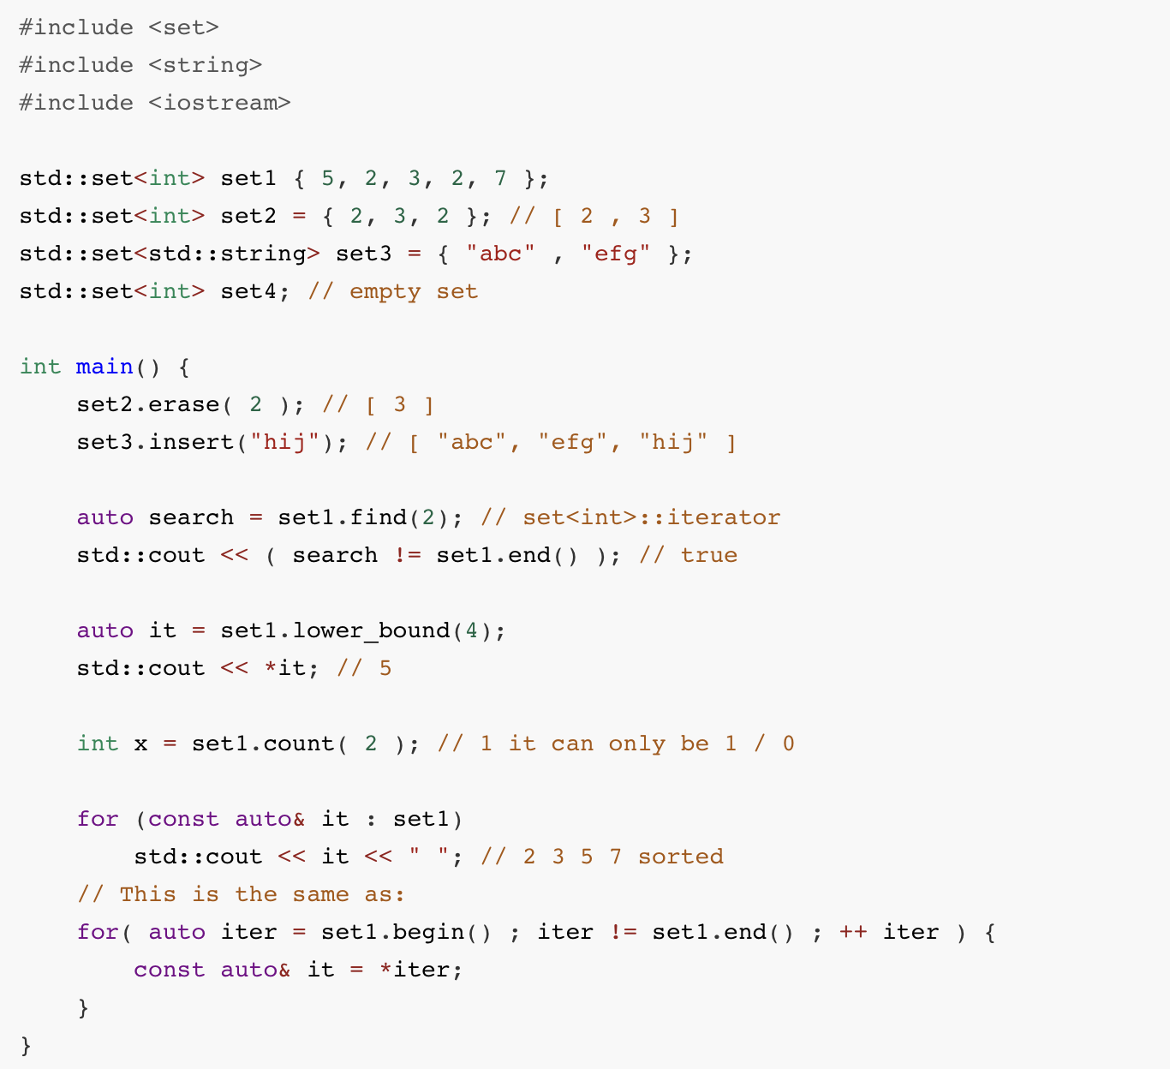
std::set example

Slide 18
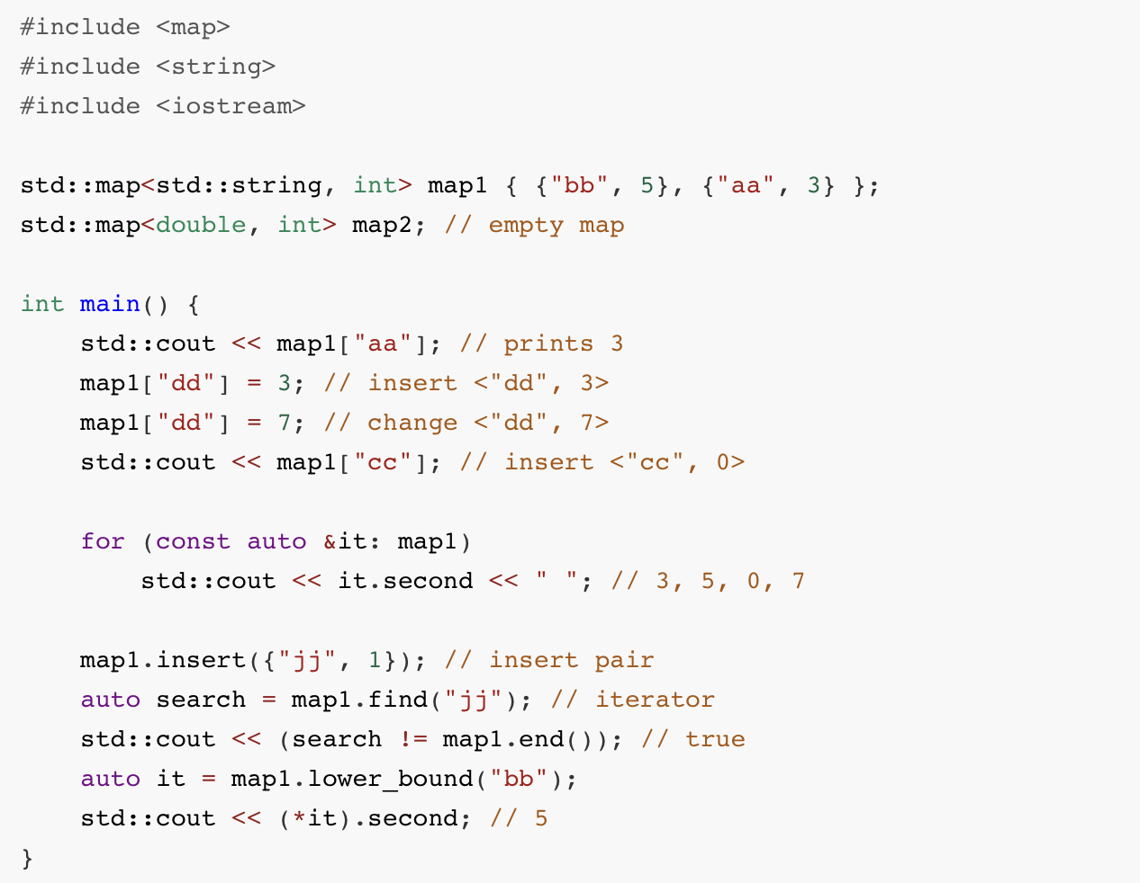
std::map example

Slide 19
Map implementation
Maps are implemented with pairs! (std::pair<const key, value>)
● Note the const! Keys must be immutable.
● Why a pair and not a tuple?

Slide 20
Two types of containers summary
Sequence:
● Containers that can be accessed sequentially
● Anything with an inherent order goes here!
Associative
● Containers that don’t necessarily
have a sequential order
● More easily searched
● Maps and sets go here!
All containers can hold all types of information! How do we choose which to use?

Slide 21
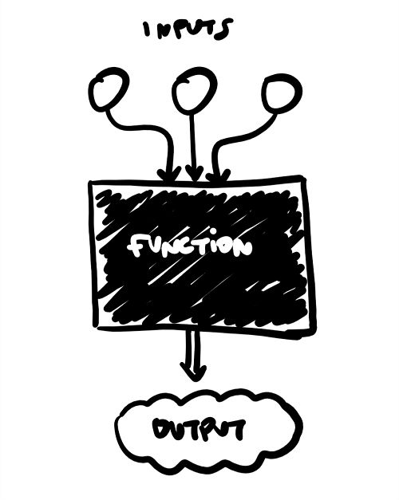
Container Adaptors
Container adaptors are “wrappers” to existing containers!
● Wrappers modify the interface to sequence
containers and change what the client is allowed to
do/how they can interact with the container.
● How could we make a wrapper to implement a queue
from a deque?

Slide 22
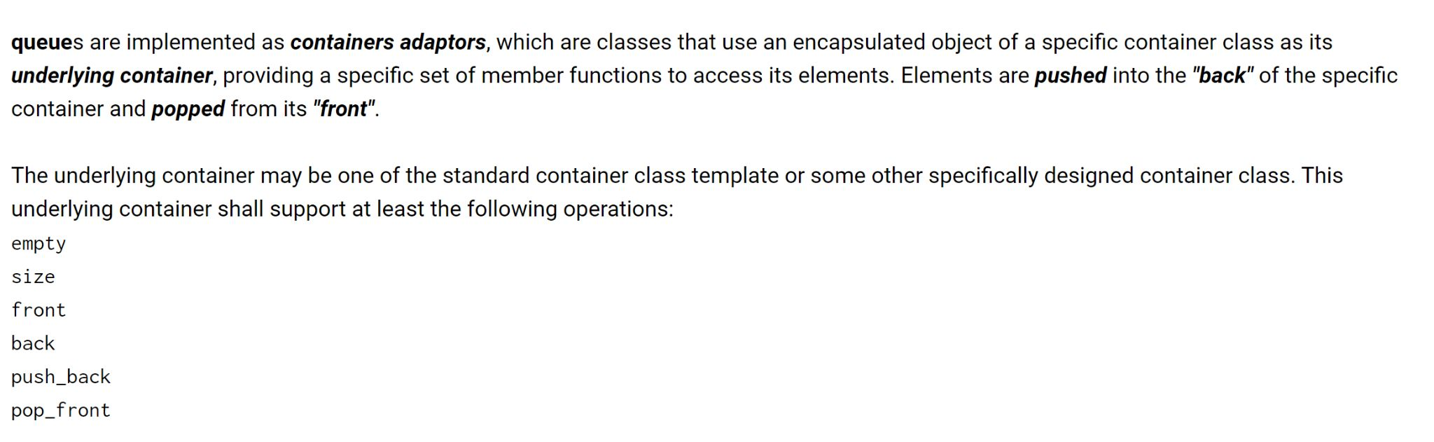
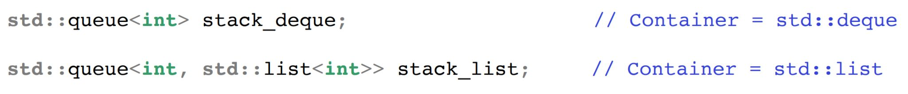
Let’s ask the STL!

Slide 23
Introducing Iterators!
Containers all implement something called an iterator!
● Iterators let you access all data in containers programmatically!
● An iterator has a certain order; it “knows” what element will come next
○ Not necessarily the same each time you iterate!

Slide 24
In the STL
All containers implement iterators, but they’re not all the same!
● Each container has its own iterator, which can have different behavior.
● All iterators implement a few shared operations:
○ Initializing iter = s.begin();
○ Incrementing ++iter;
○ Dereferencing *iter;
○ Comparing iter != s.end();
○ Copying new_iter = iter;
What other
behaviors can
iterators have?

Slide 25
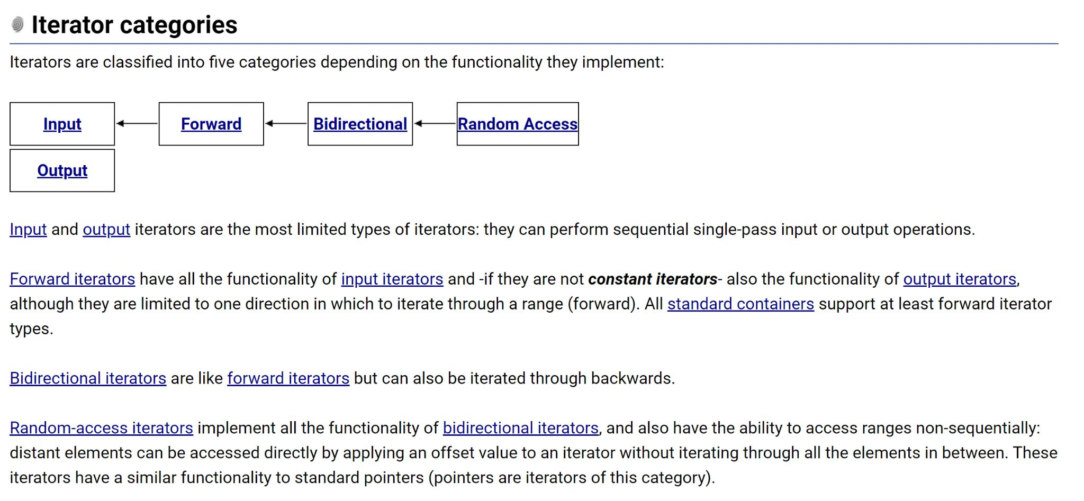
That depends!

Slide 26
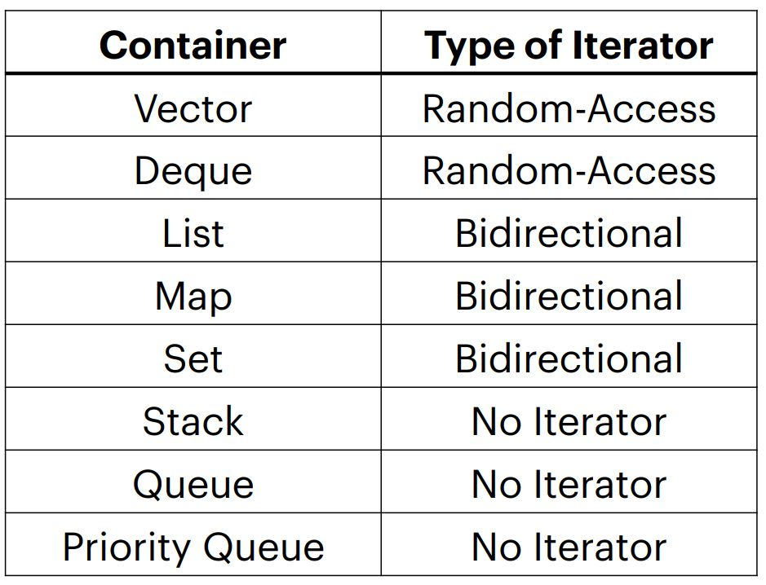
Categorizing STL iterators
Vectors and deques have the most powerful iterators!
● Creating your own containers means creating their iterators as well.
● You can access elements in stacks and queues one-by-one, but you have to change the container to do so!
● Iteration with iterators is const

Slide 27
Let’s check out that for loop again!
auto iter = set.begin() iter != set.end(); ++iter
Now we can access each element individually!
If we want the element and not just a reference to it, we dereference (*iter).

Slide 28
Let’s check out that for loop again!
If we have a map, we can use structured binding to be more
efficient while dereferencing!
std::map<int, int> m{{1, 2}, {3, 4}};
for (auto iter = m.begin(); iter != m.end(); ++iter) {
const auto& [key, value] = *iter;
}
We can also use C++ for-each loop!
for (auto [key, value]: m) {
}

Slide 29
Coding to make the world better
Qijun Zhao
qjzhao@scu.edu.cn

